Slide 1
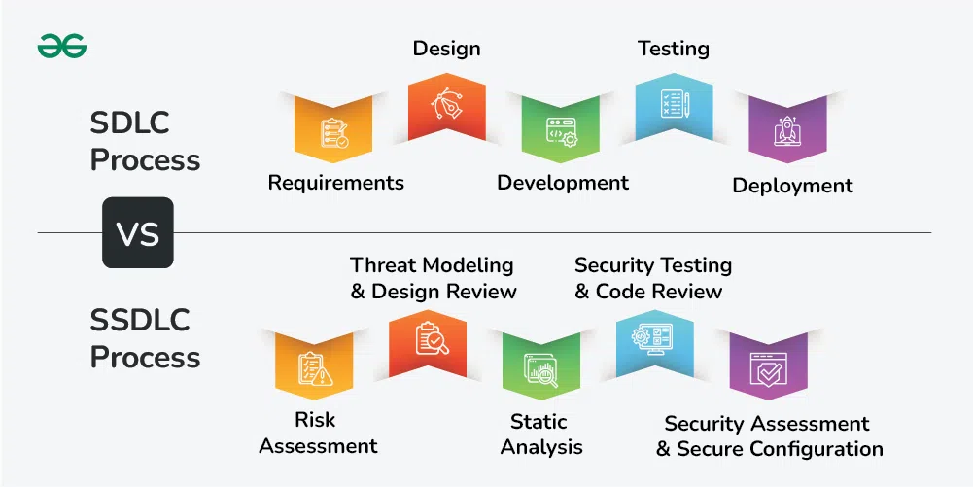
Secure Software Development MSc Computer Science Dr Zahid Ullah zahid.ullah@kaplan.com This seminar is being recorded Seminar 5

Slide 2
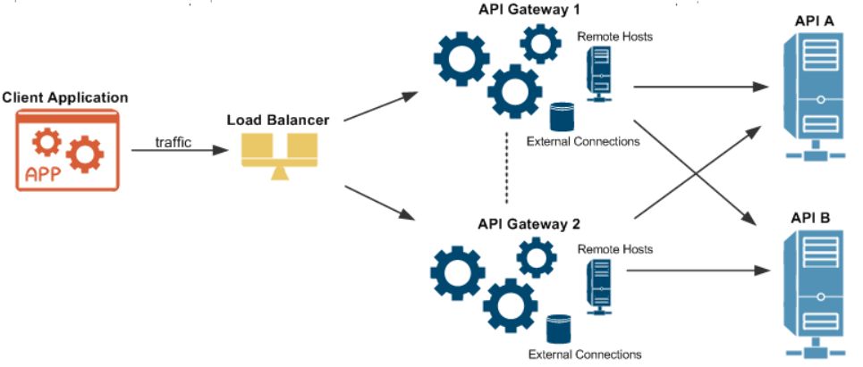
Unit 09

Slide 3
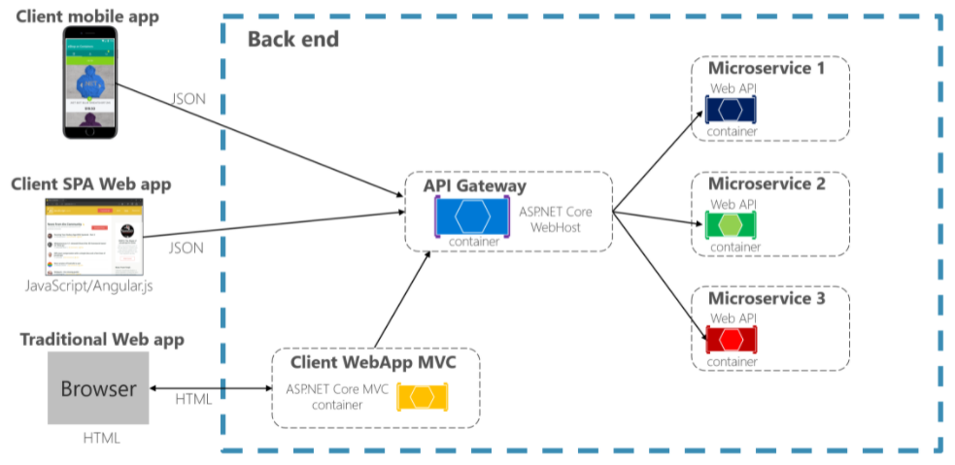
https://docs.microsoft.com/en-us/dotnet/architecture/microservices/architect-microservice-container-applications/direct-client-to-microservice-communication-versus-the-api-gateway-pattern

Slide 4
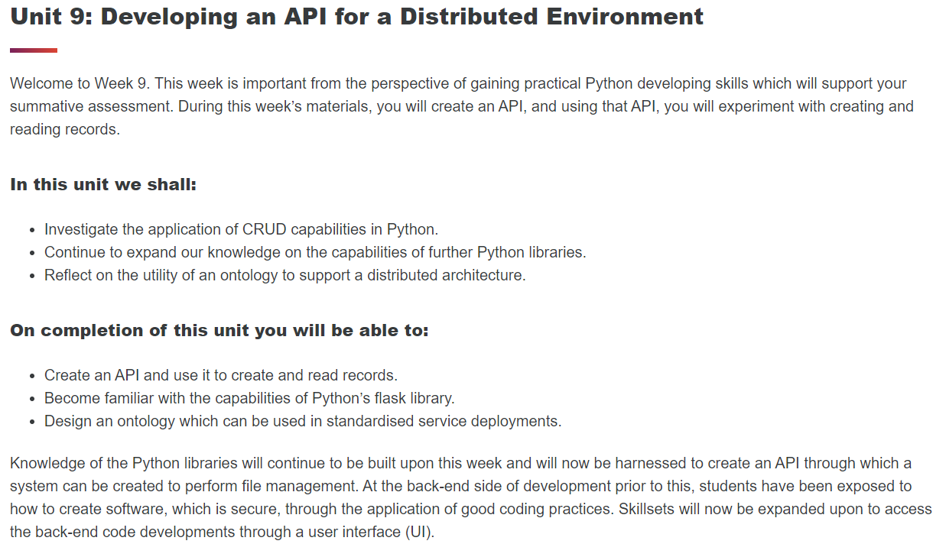


Slide 5
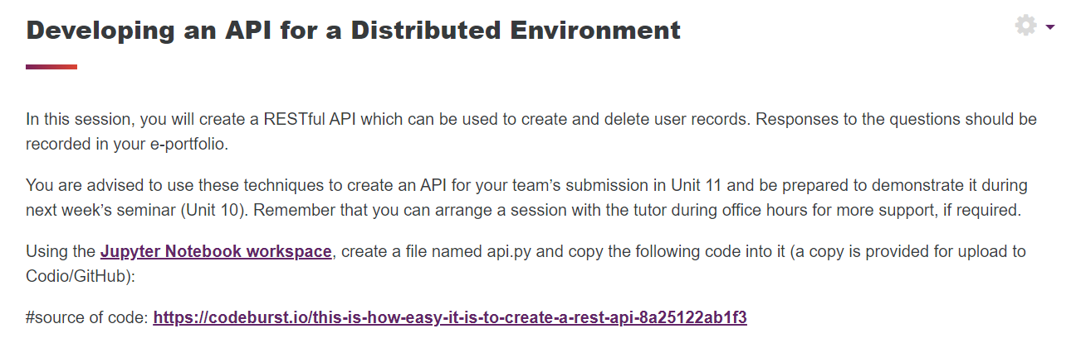

Slide 6
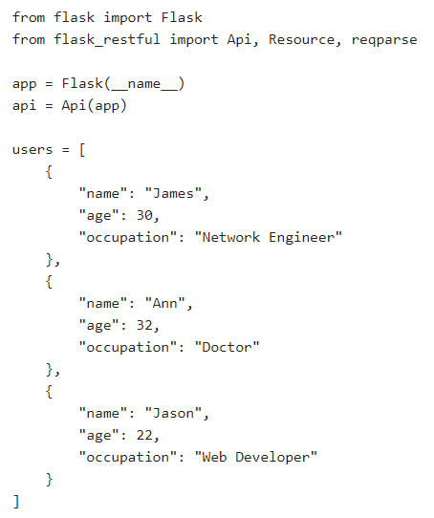
Let’s begin by importing the required module and setting up the Flask-RESTful application:
“We will be creating a RESTful API that is used to store users’ details, which will have CRUD (Create, Read, Update, Delete) functions, allowing us to create new user, get details of existing user, update details of existing user and delete existing user.”
https://codeburst.io/this-is-how-easy-it-is-to-create-a-rest-api-8a25122ab1f3
Next, we will create a lists of users using Python data structures which are lists and dictionaries to simulate a data store:

Slide 7
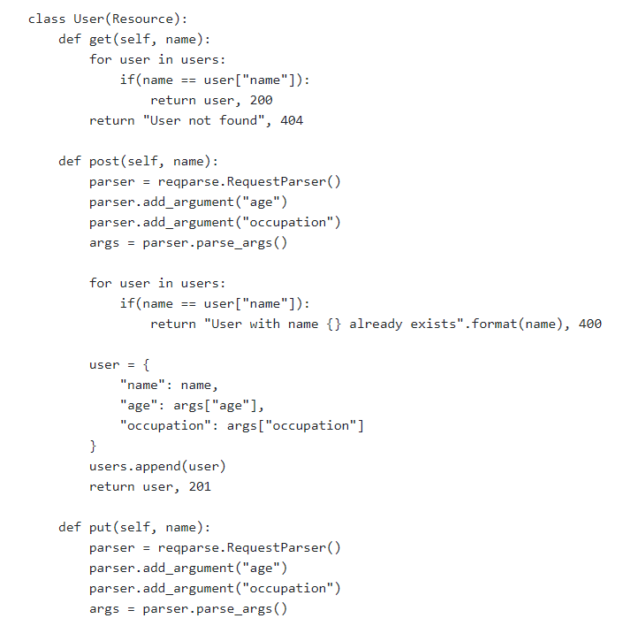
Now we will begin creating our API endpoints by defining a User resource class. Four functions which correspond to four HTTP request method will be defined and implemented:

Slide 8
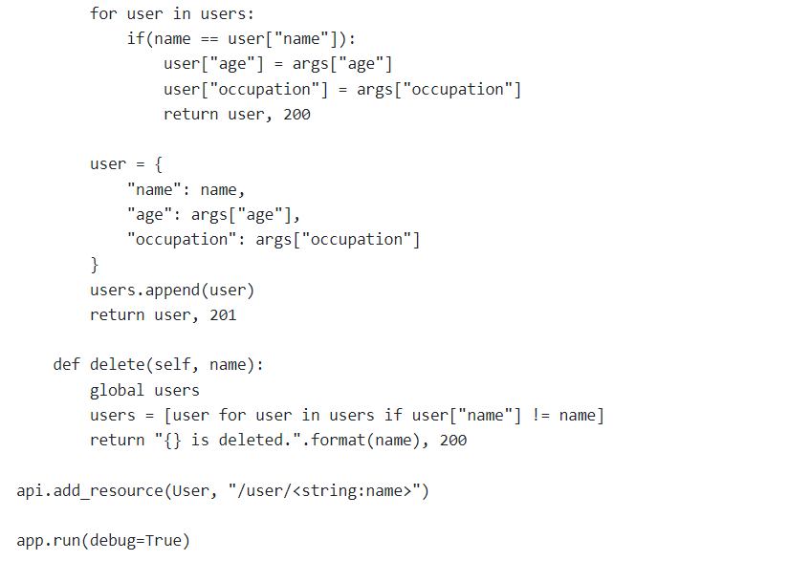
Finally, we have done implementing all the methods in our User resource, we will add the resource to our API and specify its route, then run our Flask application:

Slide 9
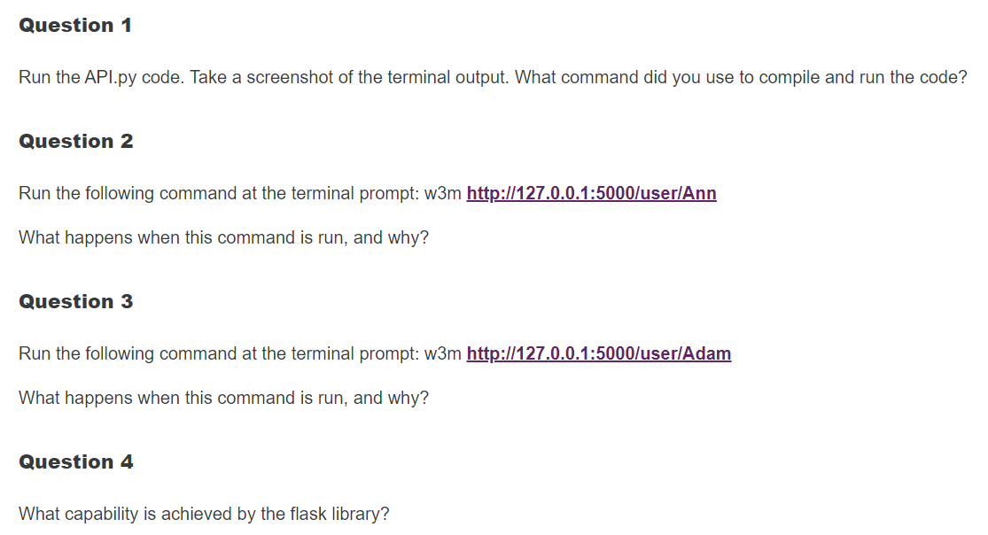

Slide 10
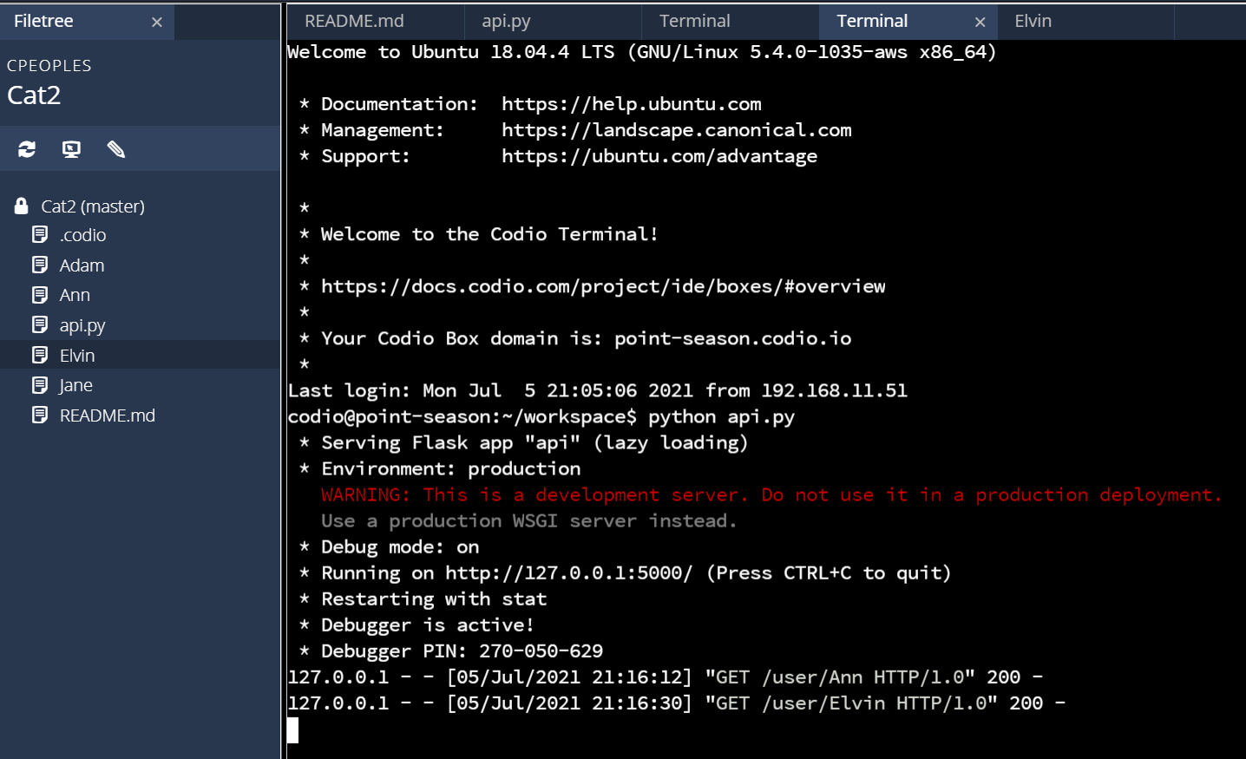
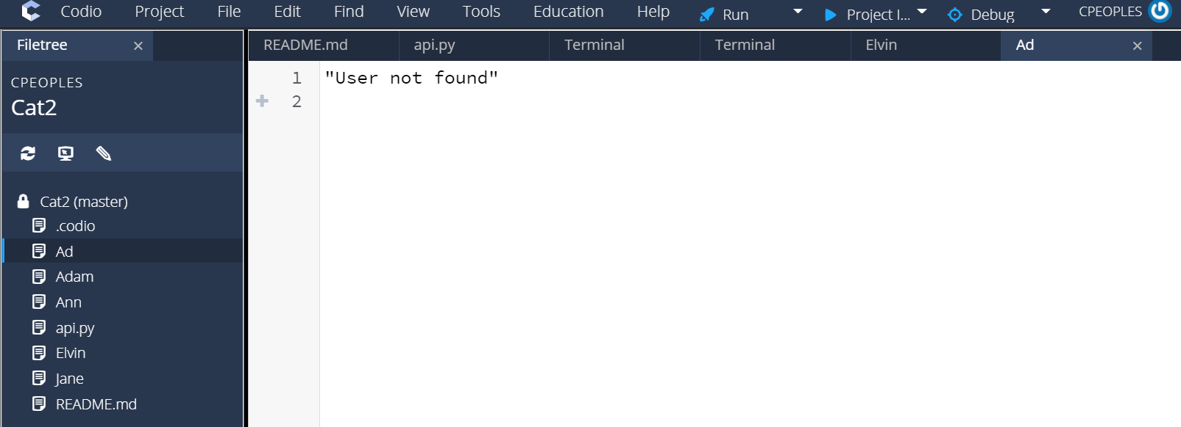
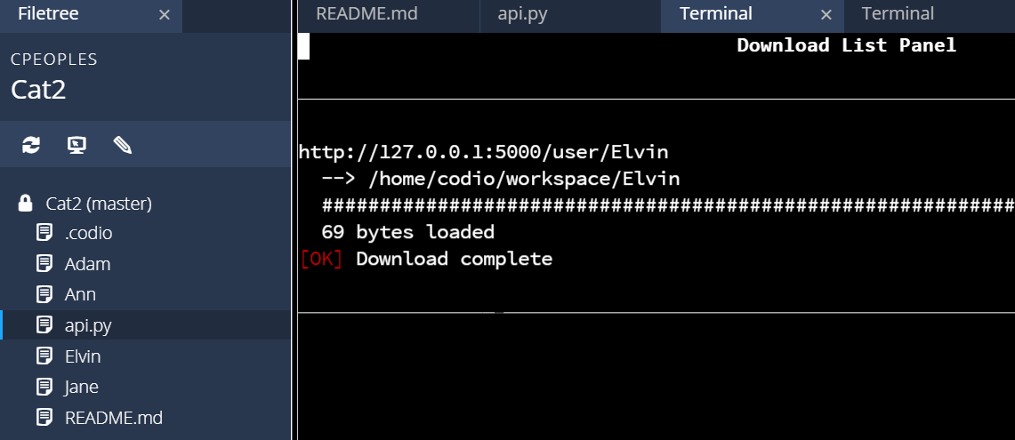
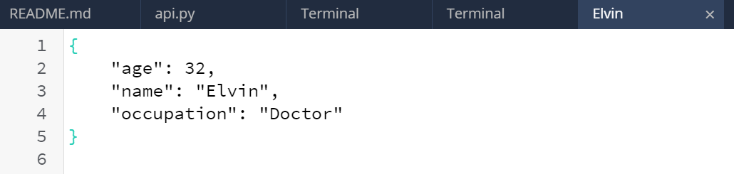

Slide 11
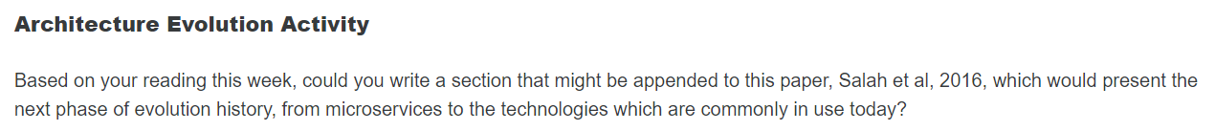
This paper illustrates how distributed systems evolved from the traditional client-server model to the recently proposed microservices architecture.

Slide 12
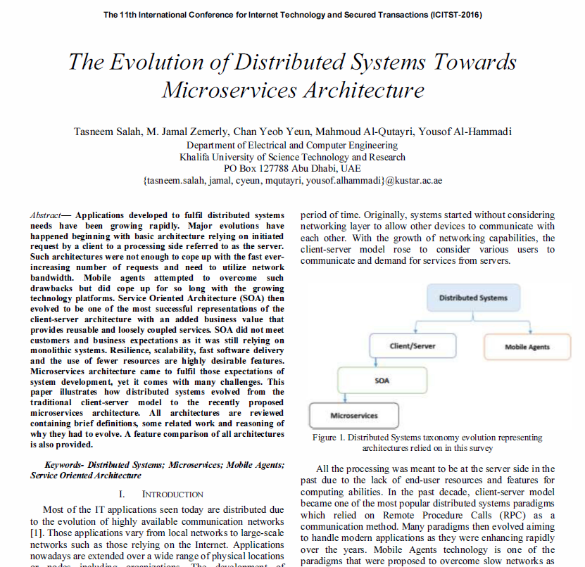

Slide 13
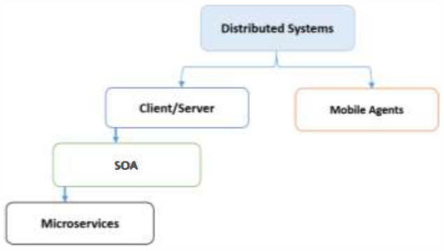
The Evolution of Distributed Systems Towards Microservices Architecture (2016)
Distributed systems taxonomy evolution

Slide 14
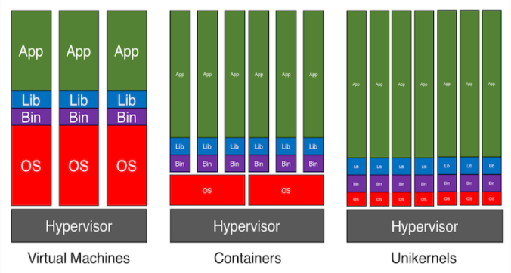
Next gen?
Unikernel
Hands-off containers
Broader serverless support
https://www.forbes.com/sites/janakirammsv/2016/01/26/unikernels-the-shiny-new-object-in-the-cloud/?sh=6100939932b8

Slide 15
Unit 10

Slide 16
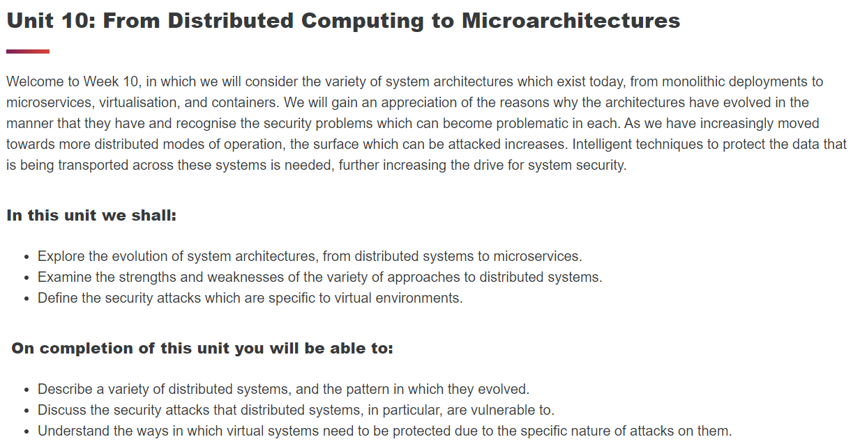
Unit 10

Slide 17
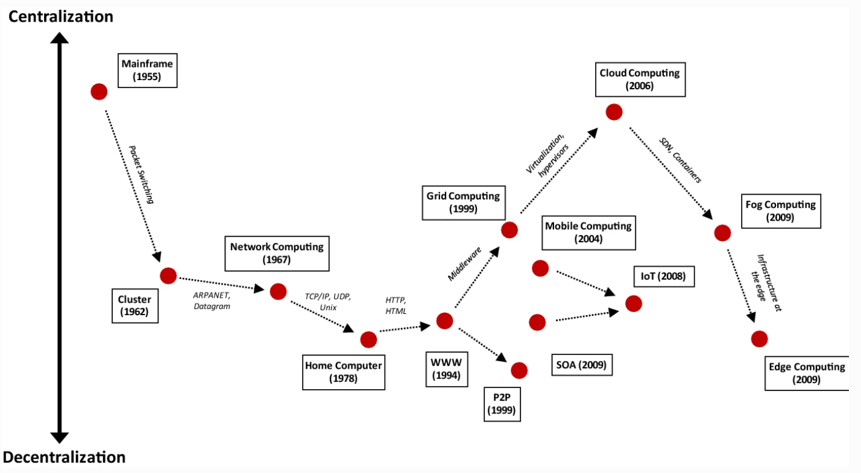

Slide 18
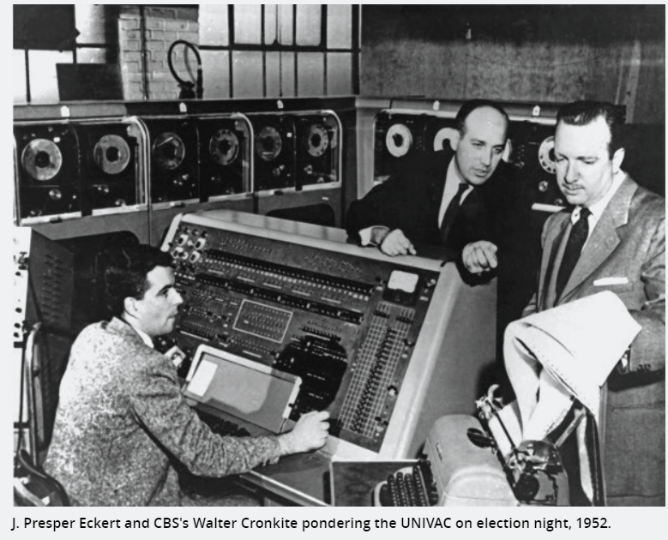
Notes:
https://arstechnica.com/tech-policy/2011/09/univac-the-troubled-life-of-americas-first-computer/

Slide 19
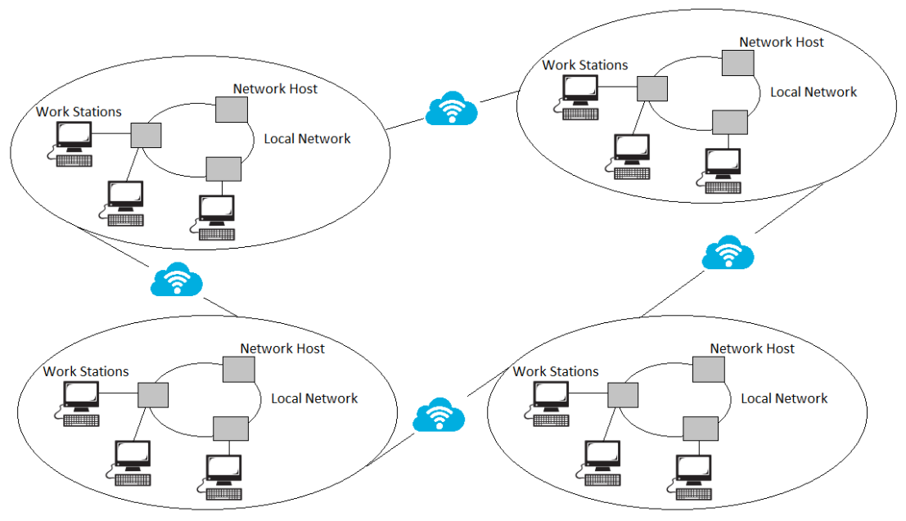
Notes:
https://subscription.packtpub.com/book/application_development/9781787126992/1/ch01lvl1sec9/distributed-computing

Slide 20
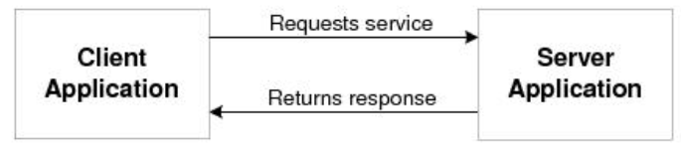
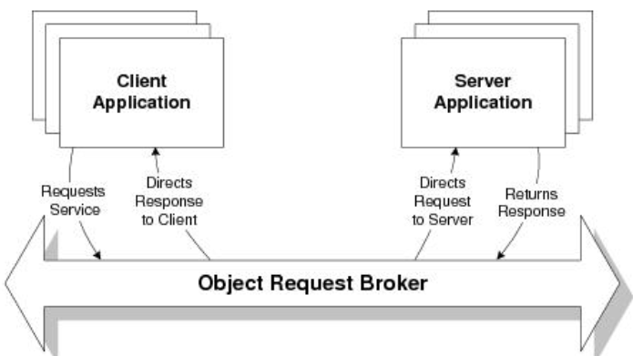
Common Object Request Broker Architecture (CORBA)
Notes:
https://docs.oracle.com/cd/E15261_01/tuxedo/docs11gr1/tech_articles/CORBA.html

Slide 21
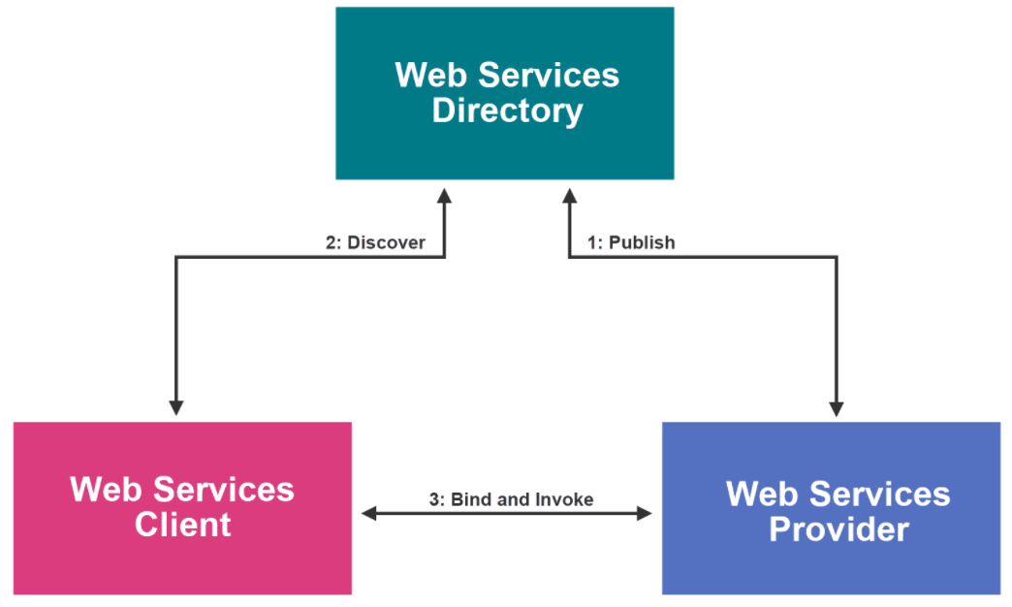
SOA

Slide 22
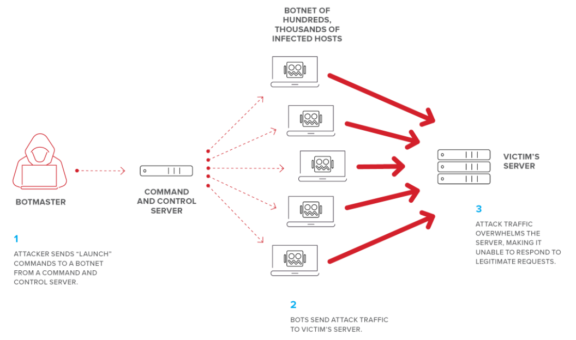
Notes:
https://www.f5.com/labs/articles/education/what-is-a-distributed-denial-of-service-attack-

Slide 23
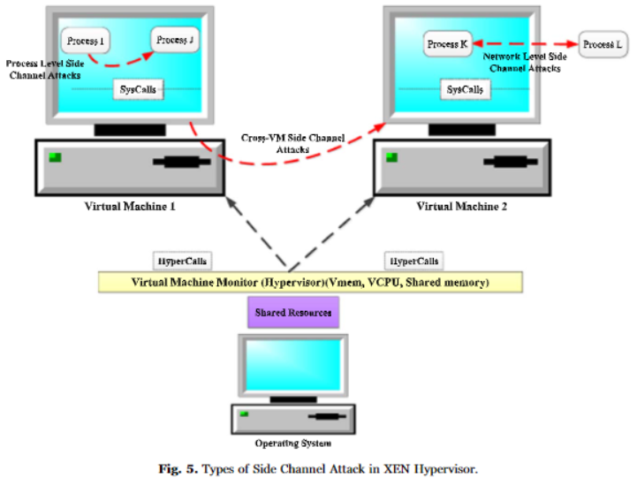
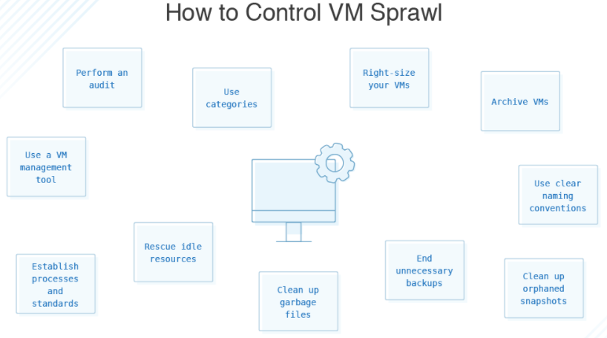
Threats with Virtualisation
Virtualisation
VM Escape
Hyperjacking
VM Sprawl
Hypervisor vulnerabilities
Cross VM Side Channel Attack
Notes:
https://dzone.com/articles/microservices-vs-soa-whats-the-difference

Slide 24
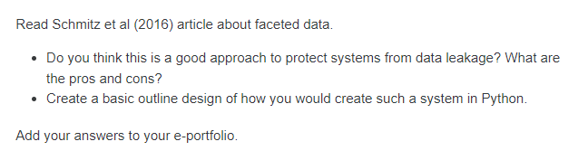
Faceted Data

Slide 25
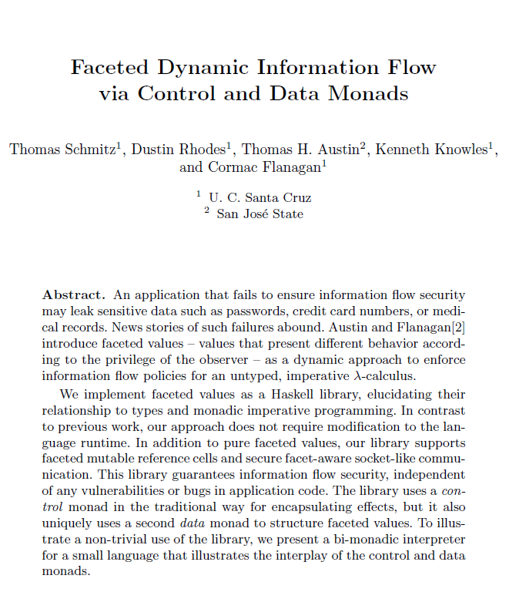

Slide 26
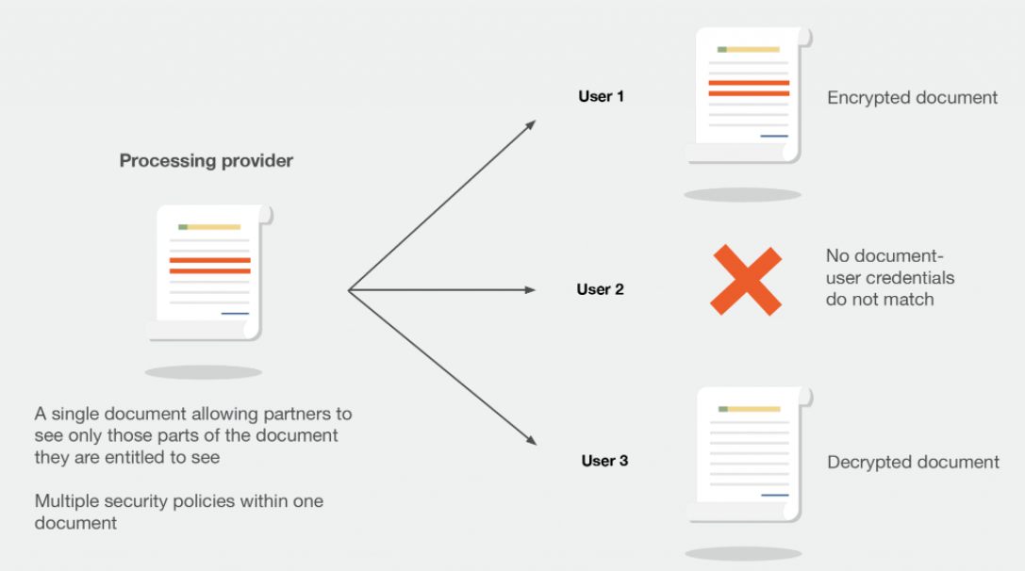
Notes:
https://airbus-cyber-security.com/products-and-services/innovation/fine-grained-access-control-and-encryption-technology-facet/

Slide 27
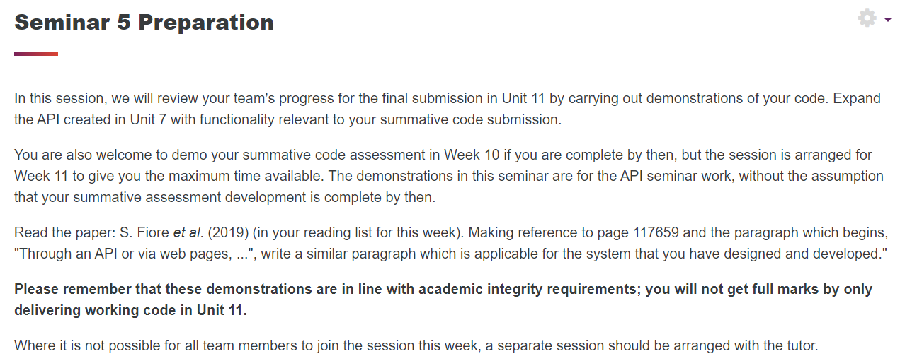

Slide 28
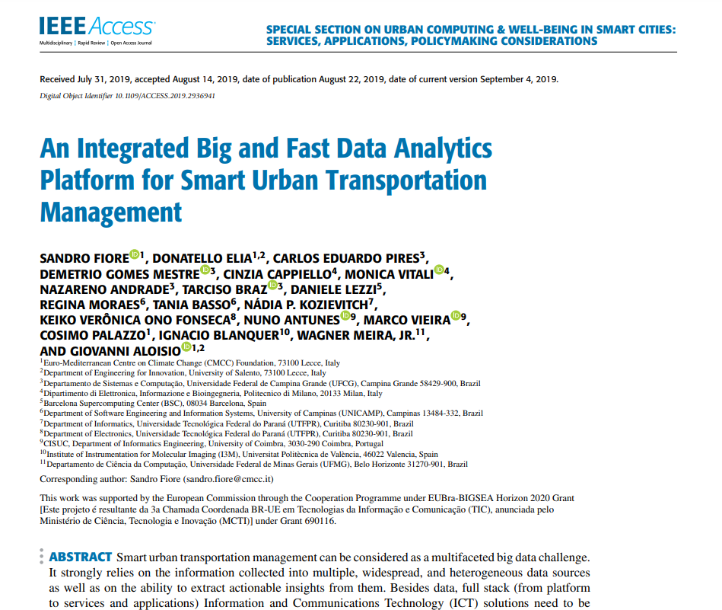
https://iris.unitn.it/retrieve/handle/11572/280230/381337/Pub1.pdf

Slide 29
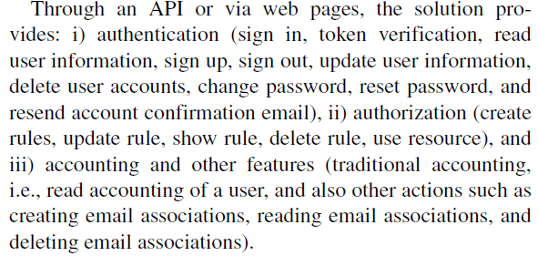

Slide 30
Read the paper: S. Fiore et al. (2019) (in your reading list for this week). Making reference to page 117659 and the paragraph which begins, "Through an API or via web pages, ...", write a similar paragraph which is applicable for the system that you have designed and developed."
Through web pages and REST API, the NCTTS web application provides: i) authentication (sign in, sign up, create user accounts, delete user accounts), ii) authorization (operator role [can verify and escalate vulnerabilities, change the status of vulnerabilities] and admin role [can add/edit/delete user accounts], manage databases), iii) reporting (submit vulnerability reports, view fixed vulnerabilities) and iV) other features (request deletion of own accounts [public user], send updates to public users via email).

Slide 31
Collaborative Discussion 2
Discussion Topic
TrueCrypt was a popular and well-respected operating system add-on that could create encrypted volumes on a Windows and/or Linux system. In addition, it was also designed to create a complete, bootable volume that could encrypt the entire operating system and data for a Windows XP system. It was discontinued in 2014.
Case Study: Read the TrueCrypt cryptanalysis by Junestam & Guigo (2014) (link is in the reading list) and then answer the following questions:
The (anonymous) TrueCrypt authors have said “Using TrueCrypt is not secure as it may contain unfixed security issues” (http://truecrypt.sourceforge.net/, 2014). Does the cryptanalysis provided above prove or disprove this assumption?
Would you be prepared to recommend TrueCrypt to a friend as a secure storage environment? What caveats (if any) would you add?
Remember to save this to your e-portfolio.

Slide 32
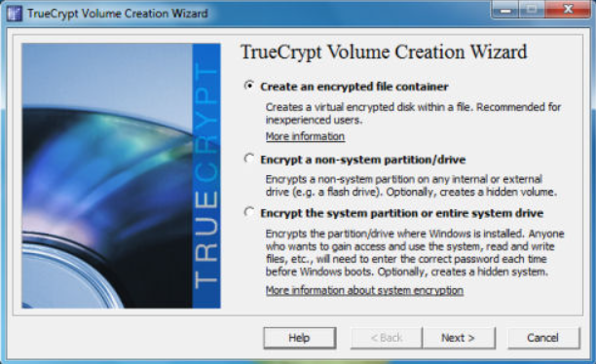
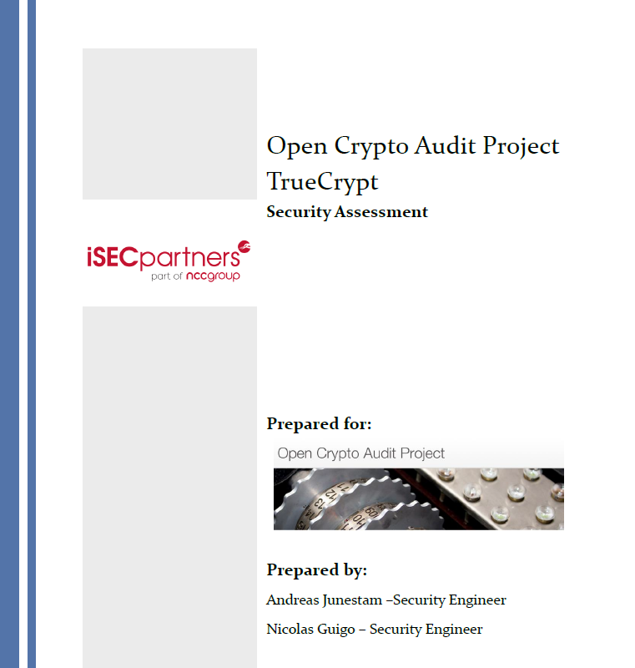

Slide 33
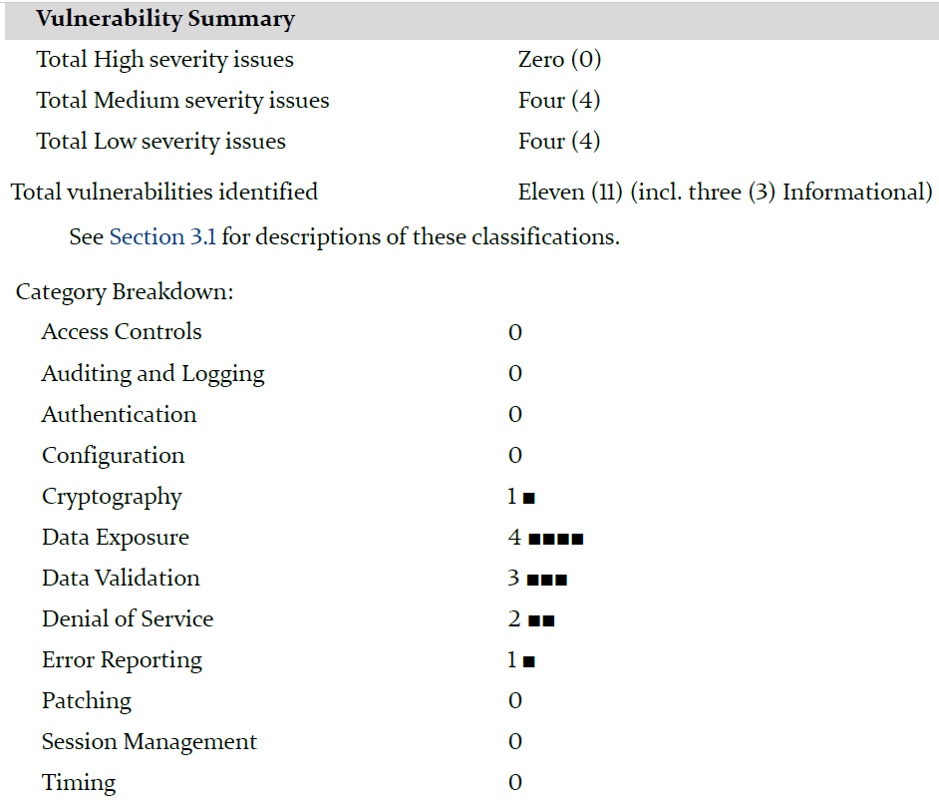
Summary

Slide 34
“Using TrueCrypt is not secure as it may contain unfixed security issues” :
Junestam & Guigo ,2014 suggest that "Overall, the source code for both the bootloader and the Windows kernel driver did not meet expected standards for secure code". This statement makes it clear that the tool is not secure.
- The audit identified many problems in the source that affected the quality and maintainability of the code, this without directly leading to security problems. It is clear that quality problem in the coding will lead to serious security problems.
- The audit specifies that "no care is taken to prevent integers from overflowing or underflowing when these operations are performed". Change to this code can lead to security issues like "Buffer overflow". It is ranked number one on the CWE Top 25 2019 (CWE,2019).
- Suppressing warning messages is another bad programing practice identified by the audit. Always better to remove the source of the warning rather then suppressing the warning.
- The fact the code is difficult to read is another bad indication for potential security issues. It makes the task of maintaining the code very hard to perform and can lead to wrong coding.

Slide 35
Would you be prepared to recommend TrueCrypt to a friend as a secure storage environment?
Reading the audit report convinced me not to recommend the tool to anyone. The tool has some serious built-in failures.
The tool is not secure. I will present two alternatives:
- To develop a new tool following the "best practice" suggested by Saltzer, J. & Schroeder, M. (1975) and others.
- Use other tools which are available to be used for example VeraCrypt or Bitlocker and others.
Each alternative has its own cost / benefit in terms of efforts and resources.

Slide 36
Security Assessment
The security assessment of Trucrypt undoubtedly proves that several unfixed security issues exist, and they are thoroughly outlined in the report. Below you will find a collection of significant problems that were discovered.
Code Quality
The report notes numerous code quality issues; these do not introduce any notable security vulnerabilities; however, with TrueCrypt being an open-source project, you run the risk of new project members introducing security vulnerabilities due to their lack of understanding practices used within the codebase.
Unsigned Integers
One of the significant code quality issues is mixing signed and unsigned integers. When programming in C++, it is recommended to use signed integers whenever possible, as unsigned integers often lead to overflow due to the integer accepting values outside the allotted memory range (LearnC++).
Vulnerabilities
One concerning vulnerability is the “Weak Volume Header key derivation algorithm”(Junestam and Giugo, 2014). Within the TrueCrypt codebase, it was discovered that the algorithm used to encrypt the volume did not apply sufficient computational complexity resulting in an encryption key that could be found using brute force techniques.
Suppression of compiler warnings
It was also found that compiler warnings were being suppressed within the code rather than directly addressing them. Suppressing warnings could provide a false sense of security to users that may not understand the code and the existing vulnerabilities.

Slide 37
Would I recommend TrueCrypt to a Friend?
Considering TrueCrypt has reached end of life, I would not recommend the application to anyone who cares about securely protecting their files. As mentioned before, there are numerous security vulnerabilities, and the tool has subsequently been replaced by projects such as VeraCrypt (VeraCrypt, 2021).

Slide 38
Peer Review thank you for your nice initial post. I can say that I agree with your position not to recommend the tool to a friend.
Lack of Code quality is a serious issue when it comes to system development. This without any consideration to security problems.
Raises many questions about the supplier's test set. There is a reasonable concern that there may also be many problems that were not manifested during the audit. Audit by its nature is limited in time and ability to discover any problematic issue. It says in the audit report that the work was performed by "Two engineers" (Junestam, A. and Giugo, N.,2014). The scope of the audit is not well defined. "They say that this review used a combination of proprietary and public automated tools, manual test techniques, and source code review to audit the application.".
Important subjects were left outside the scope of the audit for example " Algorithm implementation".
Audit of information system is a serious profession. (Patricia George & Dennis Ravenelle, Harvard University) "the examination and evaluation of an organization's information technology infrastructure, applications, data use and management, policies, procedures and operational processes against recognized standards or established policies." In our case it is not clear against which standards the tool had been evaluated. Despite the shortcomings of the methodology in the audit performed, it is still possible to obtain opinions from two engineers who have an opinion on the work of programmers. As you (Anrich) mentioned, the product ends its life and was replaced. The best five top tool to secure your data are: VeraCrypt , Bitlocker, CipherShed, FileVault 2, LUKS (PAUL BISCHOFF,2020). In this article the writer suggests not to use TrueCrypt "we recommend trying a newer alternative". It looks like a very reasonable recommendation.

Slide 39
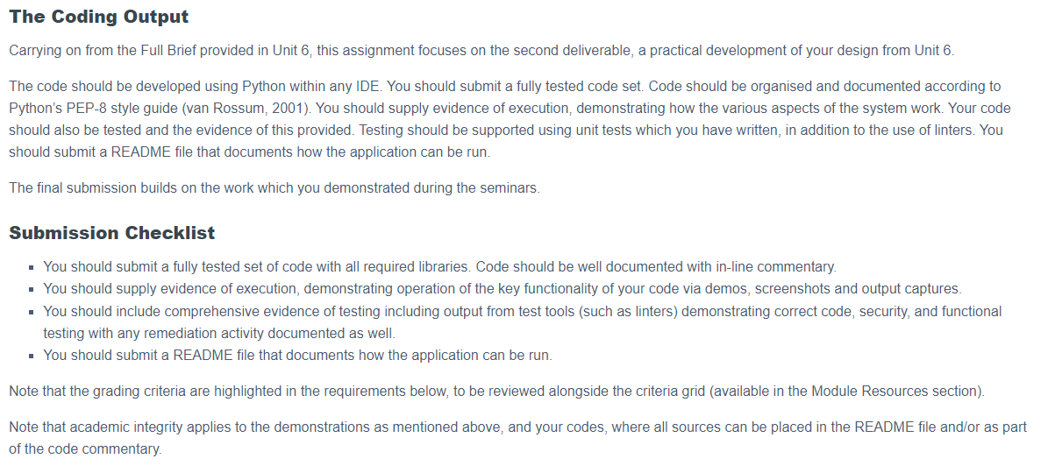

Slide 40
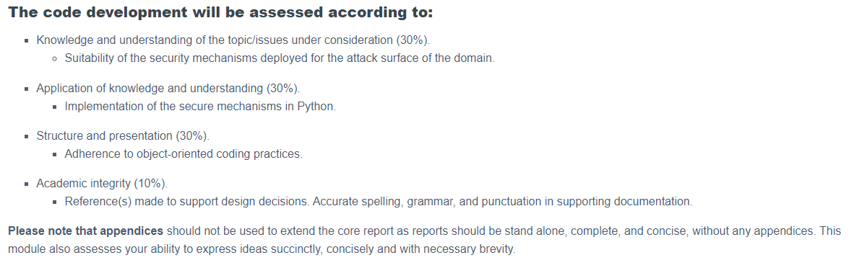

Slide 41
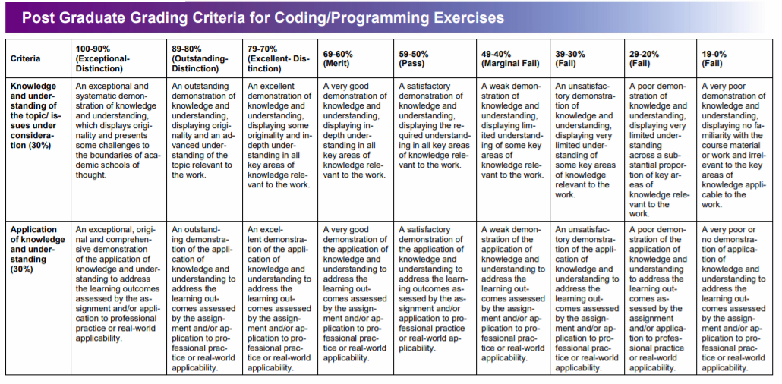

Slide 42
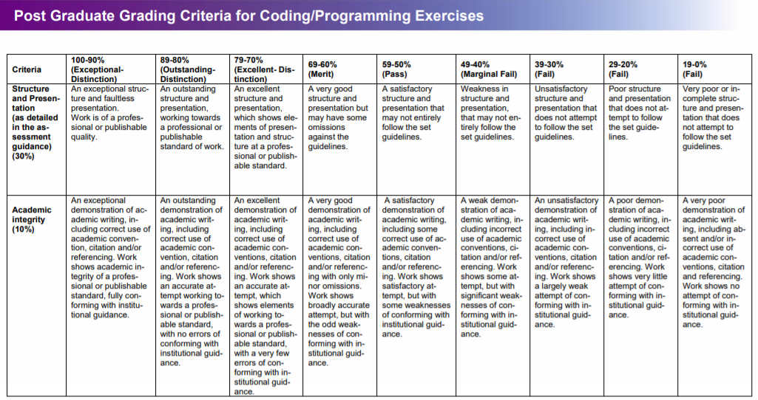

Slide 43
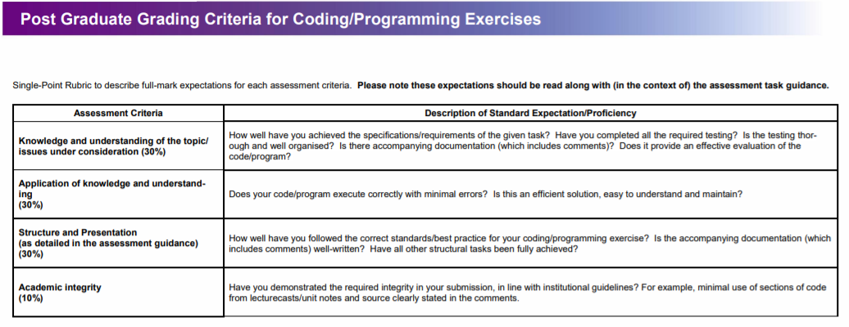

Slide 44
Secure Software Development MSc Computer Science Dr Zahid Ullah zahid.ullah@kaplan.com This seminar is being recorded Seminar 5

